Slide 1
The importance of international cooperation for your career and your research projects
EURAXESS Japan Tour seminar
27 August 2019, Hiroshima University
Dr Matthieu Py
EURAXESS Japan Coordinator

Slide 2
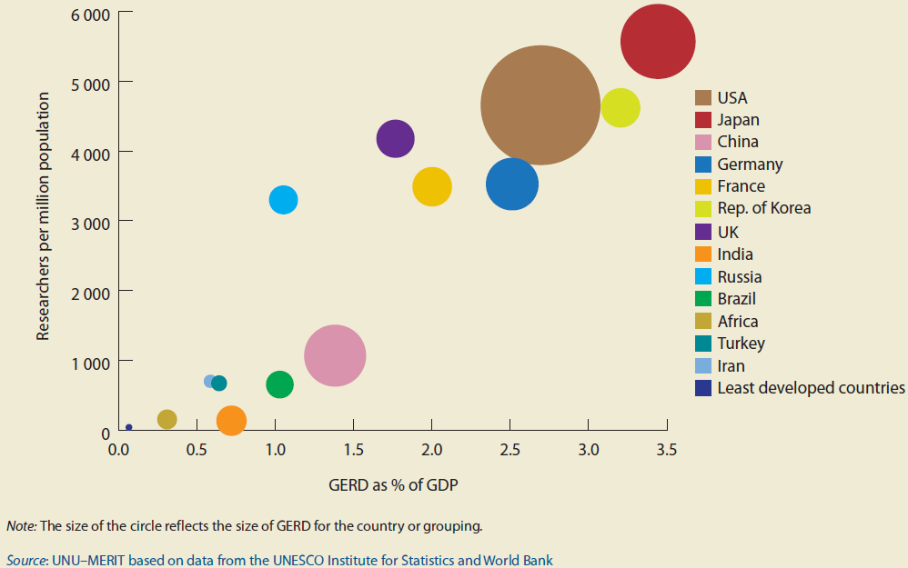
Japan specifics: Important means for R&D
Why go international with EU grants?
Japan at top level!
他国に比べ外部資金に対しての
依存性が（まだ）低い
人材ポテンシャルも高い
¹ Public R&D expenditure: JPY 3,626.4 billion (EUR 26.5 billion) [source: JST, jMOF]
² [Sources: MEXT White paper on S&T 2006, Nikkan Kogyo Shimbun 25/07/2014]
³ [Source: OECD 2011]

Slide 3
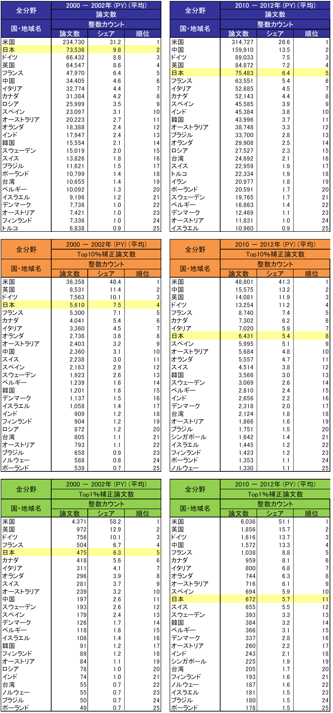
Japan specifics: Results? Not the best…
Why go international with EU grants?
結果次第の競争社会では
順位が低くなっている
x 2
NISTEP, Japanese S&T Indicators 2014, p.143

Slide 4
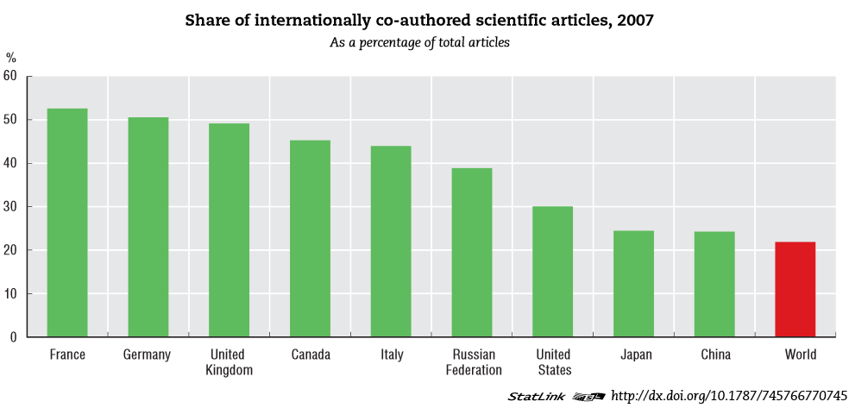
Japan lack of internationalisation: research cooperation
Why go international with EU grants?
Europe
(OECD)
Japan

Slide 5
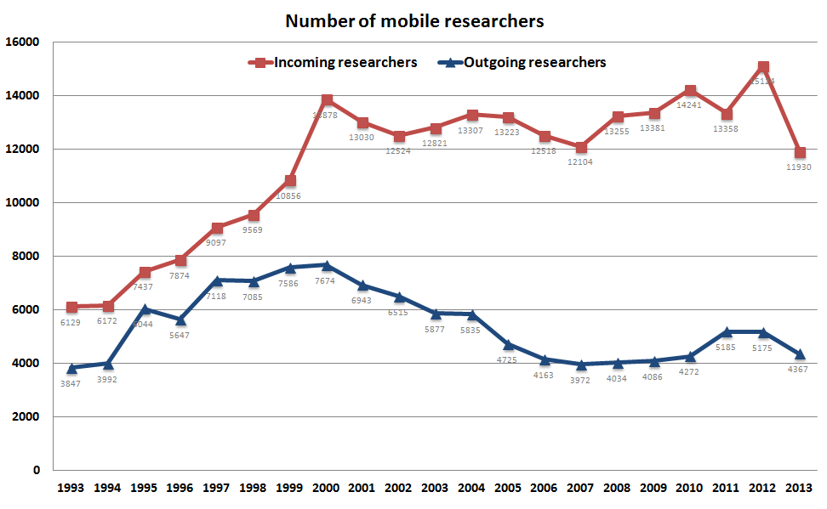
Japan lack of internationalisation: researcher mobility
Why go international with EU grants?
Research stays >1 month
MEXT: Statistics for researchers mobility, March 2015 (data ->2013)

Slide 6
Internationalisation = better research in the EU
Why go international with EU grants?
Europe
国際化(共同研究＆研究者交流)
を通じて得るものは：
個人＆機関のプロファイル・評価アップ！
Japan
OECD STI Scoreboard 2013

Slide 7
PhD, Post-doctoral & mid-career mobility to Europe, research cooperation with Europe: WHY?
Excellence:
Programmes (H2020, ERC, MSCA, National…)
Infrastructures
Human Resources (other researchers!)
  Diversity and openness:
  European countries open labour market = internal mobility
  Open competition, open calls, open recruitment… & Open science!
  Are you aware of your options?
  Are available offers clear to you?
  ➔Let’s check (some of) them together!
Notes:
EURAXESS is an implementation tool of ERA. Our mandate is to assist researchers on the ground with their mobility ambitions.

Slide 8


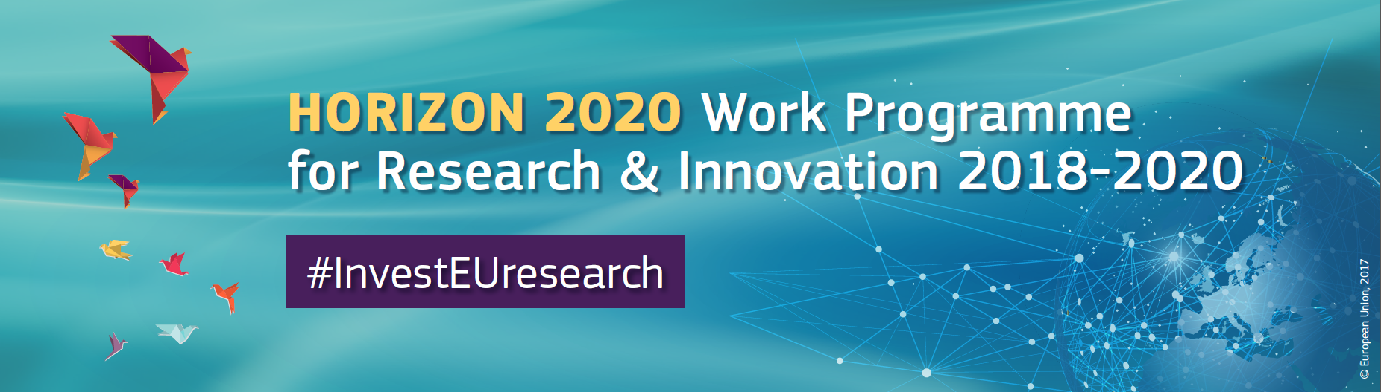

Opportunities for Research Collaboration
under Horizon 2020 programme
EURAXESS Japan Tour seminar
Hiroshima University, 27 August 2019
Materials from: Tom Kuczynski
Science and Technology
EU Delegation to Japan

Slide 9
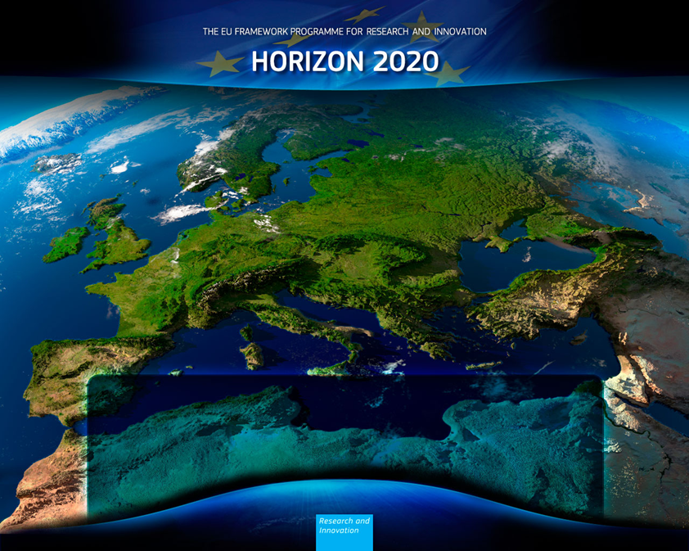

Benefits of collaboration under Horizon 2020
- Open to the world – join top level research teams
- Networks
- all TRL (from basic research to market)
- high level joint publications in EN
- communication in EN
- learning and training programmes (for young researchers, support staff)
- one entry point, one sets of rules
(leading role of the coordinator)
- success rate ca. 15%
- internationalization (average project 10 organisations 5-7 countries)
- exchange / receive researchers (IF, RISE)
- standardization / trends
- competition / collaboration
Open to the world
Notes:
Research and innovation have been placed at the centre of the EU budget for the programming period between 2014-20. EU leaders believe strongly that research and innovation will create the economic opportunities of tomorrow.
Horizon 2020, the new programme for research and innovation has been allocated a budget of almost 80 billion euros over the next seven years.
Europe, like much of the world, faces major challenges such as ageing populations and the depletion of natural resources. This affects all of our lives directly, for example through high health care costs, rising energy prices, congested roads, and threats to security.
Horizon 2020 is designed to address these societal challenges through funding excellent science, technology and innovation.
[It is central to the Europe 2020 strategy for smart, sustainable and inclusive growth, the Innovation Union flagship to create a knowledge society, and the goal to complete the European Research Area as a single market for knowledge.]

Slide 10
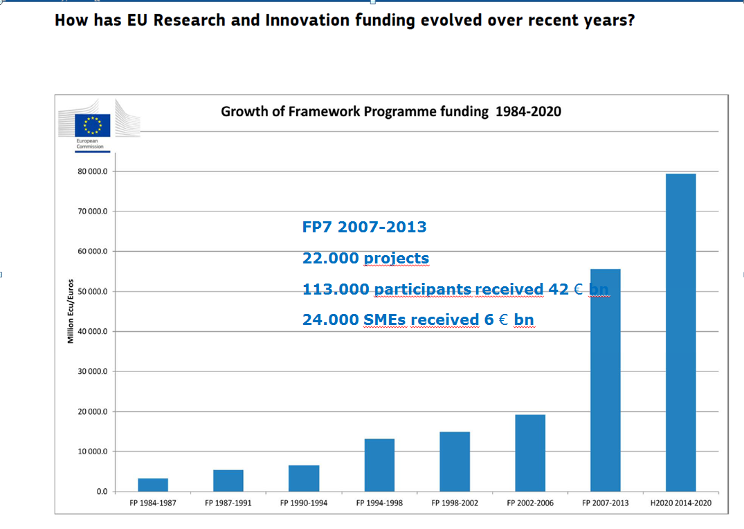
Proposal
EUR 100 billion
Horizon Europe
2021-2027

Slide 11
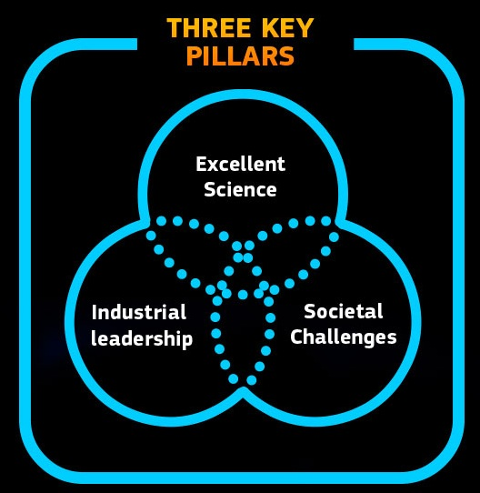
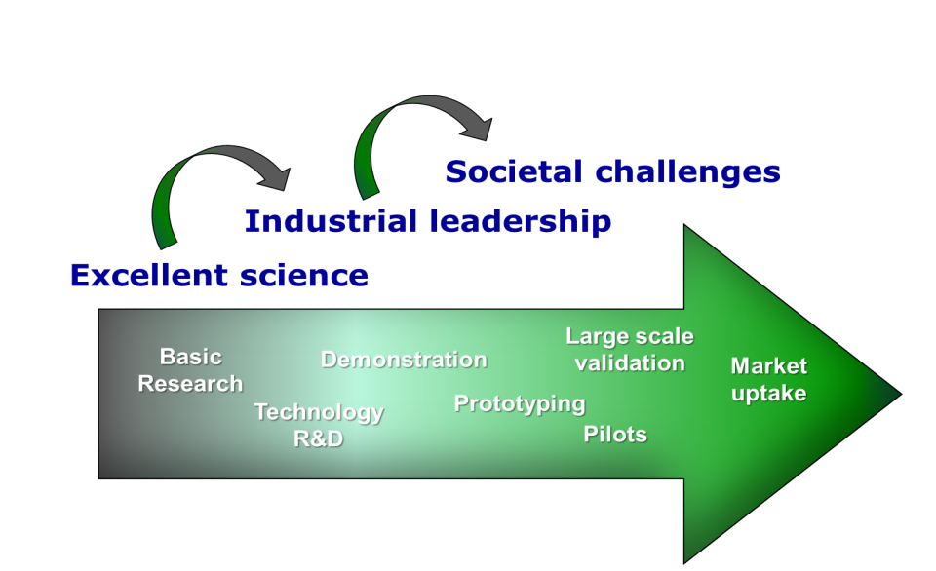

Slide 12
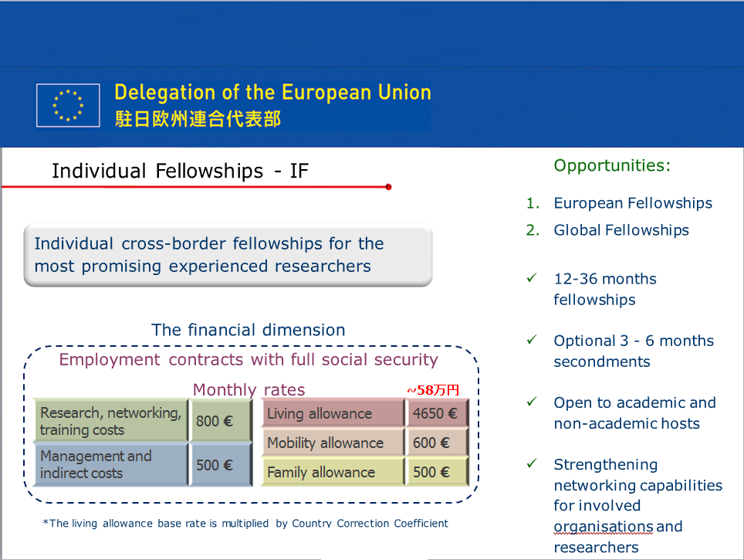
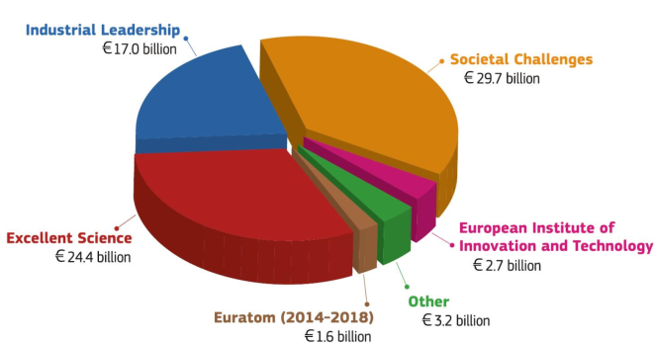
Excellent science
(EUR 24 billion)
Marie Skłodowska-Curie actions Providing opportunities for training and career development of individual researchers European Research Council Supporting top researchers from anywhere in the world to work in Europe
Future and Emerging Technologies Supporting visionary thinking through collaborations between science and engineering
Research infrastructures- including e-infrastructure Ensuring access to world-class facilities
Notes:
This first pillar includes several activities aimed at individual researchers of any nationality – offering very interesting opportunities to spend part of their research career in Europe.
The European Research Council offers extremely generous and flexible grants for researchers , from anywhere in the world, to establish research groups in Europe. The grants support investigator driven, 'frontier' research in any scientific discipline and there is only one criterion; excellence.
The Marie Sklodowska Curie actions support the career development and training of researchers –in all scientific disciplines, through transnational, intersectional and interdisciplinary mobility. Grants for all stages of researchers' careers are available. The MSCA will be the main EU programme for doctoral training, funding 25 000 PhDs.
Funding in millions: European Research Council €13 095; Future and emerging technologies €2 696; Marie Sklodowska- Curie Actions € 6 162; Research Infrastructures €2 488

Slide 13
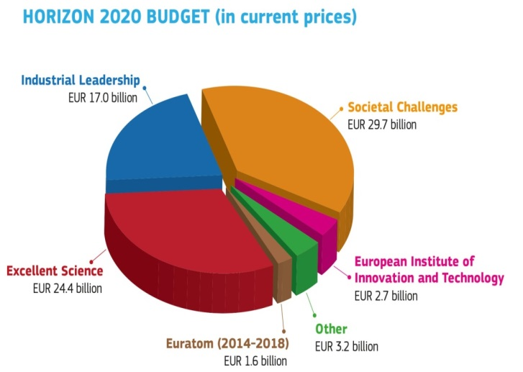
Industrial Leadership
(EUR 17 billion)
Leadership in enabling and industrial technologies
  Advanced manufacturing, microelectronics, nanotechnology, biotechnology, ICT and space
Access to risk finance
Leveraging private finance and venture capital for research and innovation
Innovation in SMEs
Fostering all forms of innovation in all types of SMEs
Collaborative research: >3 independent participants from different Member States or Associated Countries. In addition, participants from any other country can also be included
Participate in a regular call: join a consortium and sign a grant agreement or
Participate in a joint call (e.g. in ICT, supported by MIC/NICT)

Slide 14
Societal Challenges
(EUR 29.7 billion)
Health, demographic change and wellbeing
Food security, sustainable agriculture and forestry, marine and maritime and inland water research and the bioeconomy
Secure, clean and efficient energy
Smart, green and integrated transport
Climate action, environment, resource efficiency and raw materials
Inclusive, innovative and reflective societies
Secure societies
Collaborative research: >3 independent participants from different Member States or Associated Countries. In addition, participants from any other country can also be included
Participate in a regular call: join a consortium and sign a grant agreement or
Participate in a joint call (e.g. in ICT, supported by MIC/NICT)

Slide 15
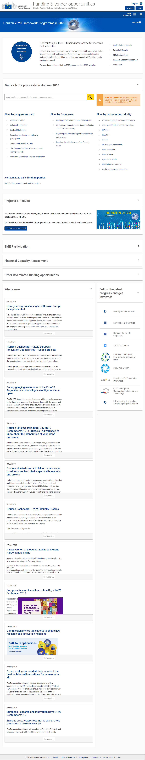

Slide 16
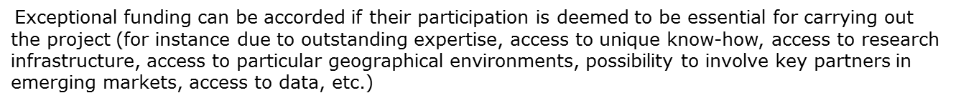
共同研究の実施要件
研究テーマ | 研究のタイプ ( Code ) | 活動 | 構成要件 (Minimum) | 助成率 | 期間 | 平均助成額
Top Down | Research & Innovation Action ( RIA ) | 基礎研究、開発、商品化技術の確立 | 3つのEU・関連国から３法人 | １００％ | ３６ - ４８か月 | €２．０ - ５．０M
同 | Innovation Action ( IA ) | 新たな商品やサービスの検討・企画 | 3つのEU・関連国から３法人 | ７０％ | ３０ - ３６か月 | €２．０ - ５．０M
同 | Coordination ＆ Support Action ( CSA ) | 標準化、政策対話、 普及 | 1つのEU・関連国から1つの法人 | １００％ | １２ - ３０か月 | €０．５ - ２．０M
Bottom Uｐ | Research & Innovation Staff Exchange ( RISE ) | スタッフ・若手研究者のキャリア開発の為の 短期交流 | 2つのEU・関連国から2法人 + 第3者 （EU・関連国も可） | １００% | ４８か月以内 | €０．１ - ０．８M
EU・関連国以外の経済発展国（日、米、中、韓、露、など）からの参加企業・機関は、自動的には助成金は受けられない。
日系企業の欧州現地法人は助成の対象。
日欧共同公募などでは、日本の機関に対して助成がある。（総務省、NICT、JST、 など）
プロジェクトのコーディネータ（幹事役）にはEU/関連国の機関が就く。

Slide 17
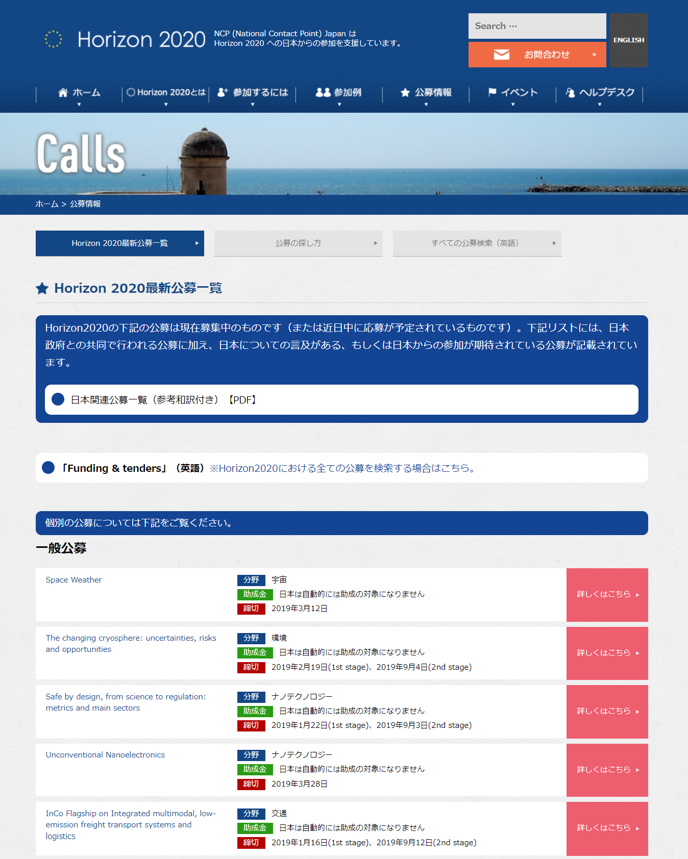
Coordinated Calls &
Japan mentioned in Open Calls
年別の一覧 (参考和訳付）
Horizon全ての公募へ
締切日順 （個別）
NCP-Japan ホームページより

Slide 18
Excellent science
(EUR 24 billion)
Marie Skłodowska-Curie actions Providing opportunities for training and career development of individual researchers European Research Council Supporting top researchers from anywhere in the world to work in Europe
Future and Emerging Technologies Supporting visionary thinking through collaborations between science and engineering
Research infrastructures- including e-infrastructure Ensuring access to world-class facilities
Notes:
This first pillar includes several activities aimed at individual researchers of any nationality – offering very interesting opportunities to spend part of their research career in Europe.
The European Research Council offers extremely generous and flexible grants for researchers , from anywhere in the world, to establish research groups in Europe. The grants support investigator driven, 'frontier' research in any scientific discipline and there is only one criterion; excellence.
The Marie Sklodowska Curie actions support the career development and training of researchers –in all scientific disciplines, through transnational, intersectional and interdisciplinary mobility. Grants for all stages of researchers' careers are available. The MSCA will be the main EU programme for doctoral training, funding 25 000 PhDs.
Funding in millions: European Research Council €13 095; Future and emerging technologies €2 696; Marie Sklodowska- Curie Actions € 6 162; Research Infrastructures €2 488

Slide 19


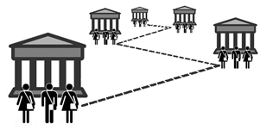

Marie Skłodowska-Curie Actions (MSCA)
Support of researcher’s Mobility
ITN ： Develop early-stage
researcher’s skills
IF ： Experienced researchers work
by moving countries or
sectors to acquire skills
RISE: Exchange of staff members
to transfer knowledge
COFUND：Co-Funding regional /
inter-national programme

Slide 20
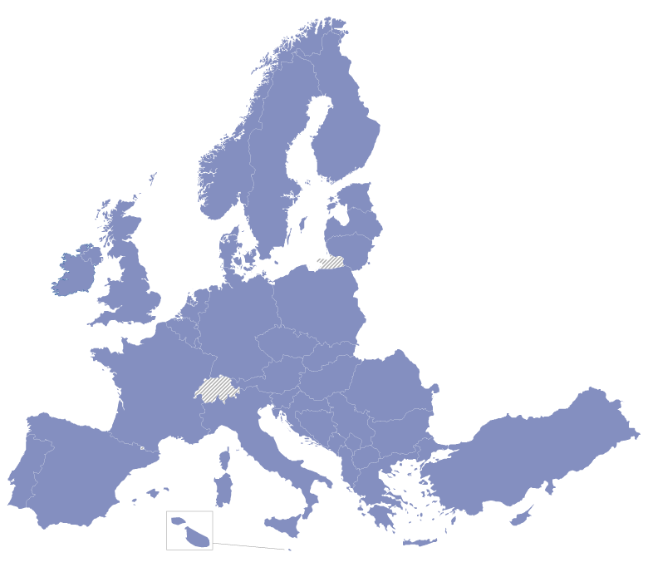
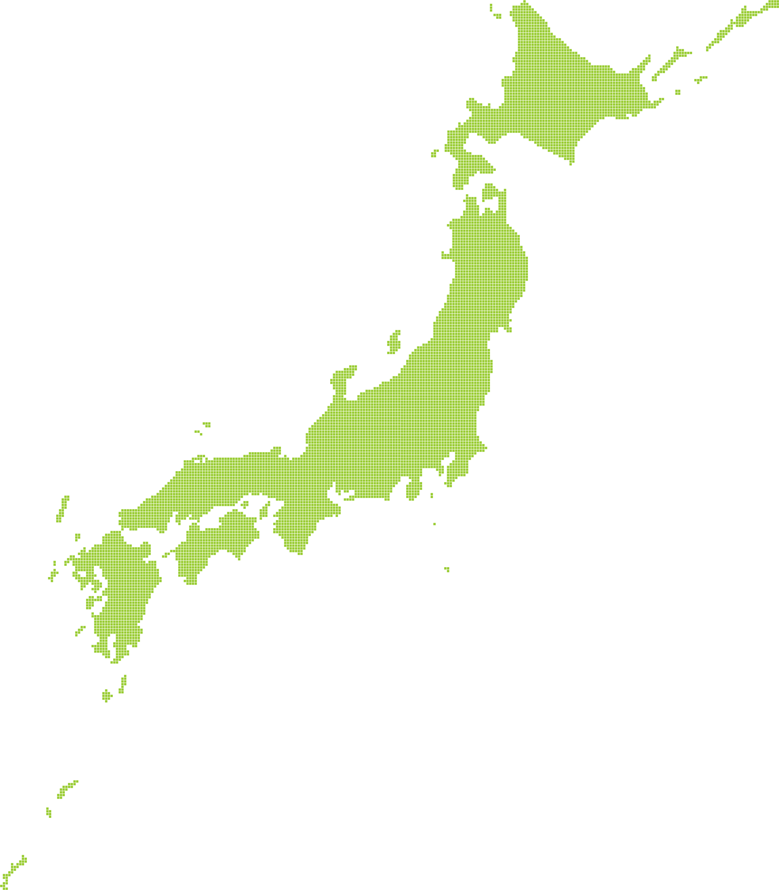
Marie Skłodowska-Curie Actions (MSCA)
Research Innovation Staff Exchange ( RISE )
Joint research and innovation activities implemented by the exchange of
Individual staff for 1-12 months.
Academia & Non-academia,
Different countries & sectors
Exchange of researcher, staff member & manager
Bottom Up

Slide 21
Marie Skłodowska-Curie Actions (MSCA)
RISE Condition
Minimum Eligibility Conditions :
At least 3 independent participants in 3 different countries and
- 2 participants from different MS/AC *+ 3rd country or
- If all in MS/AC*, at least 1 academic and 1 non- academic
Types of members are Early-stage researchers, Experienced researchers,
Managerial / Administrative/Technical staff
Actively engaged at least 1 month prior to first secondment
Each researcher seconded (1-12 months)
Maximum 540 person-month
Duration of projects: Max 4 years
Partnership Agreement : Role, IPR, Payment of funding, etc.,
⇒ Strongly recommended
*MS/AC (Member State /Associated Country)

Slide 22
Marie Skłodowska-Curie Actions (MSCA)
RISE Eligibility for funding
Secondments from Japan to EU
  To a MS/AC from organizations located in Japan are not eligible for funding
Secondments from EU to Japan
  Institutional costs correspond to subject to inter
  Japanese partner is allowed to receive a part of the “ Institutional costs“
  (2,500 Euro per person/month ) incurred during a secondment from a EU
  beneficiary to a Japanese partner subject to internal agreements.
  The amount shall be transferred to Japanese partner by the EU beneficiaries
  ( not paid directly from EC )
⇒ Sign a “ Partnership Agreement” is strongly recommended

Slide 23
Marie Skłodowska-Curie Actions (MSCA)
RISE Eligible Costs
Unit costs for secondments eligible for funding
€ （Person/month）
Not applicable
Partially Applicable to Japanese Partner
Marie Skłodowska-Curie Action | Staff member unit cost * person/month Top-up allowance | Institutional unit cost * person/month
 |  | Research, training and networking costs | Management and indirect costs
Research and Innovation Staff Exchange | （2.100） | 1.800 | 700
Travel
Accommodation
Subsistence cost
Purchasing consumables
Laboratory cost
Participation conference,
workshops, activities
coordination, and
review meetings
Administrative and
financial management,
logistics, ethics, legal
advice, documentation
etc.

Slide 24
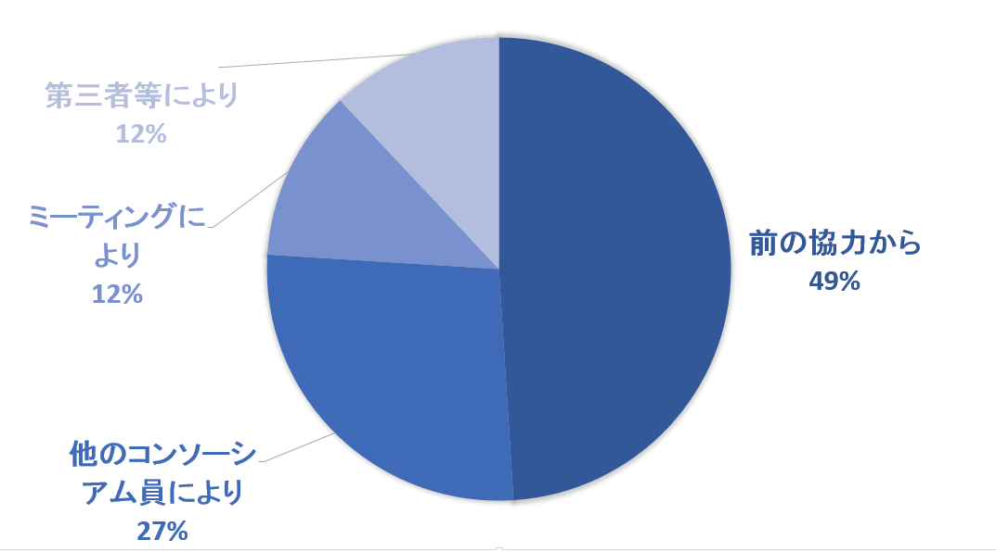
Form a consortium
How to form a consortium with European partners
  Business partner / Global partner of your entity
  Personal relationship through International conference
  Introduced by common acquaintance
  Introduced by NCP network
Form a consortium with well experienced partner as thorough
preparation work is required
Prepare financial arrangements ( JSPS or other resources )
Others through
3rd party (12%)
From previous collaborations (49%)
Met at meetings (12%)
Invited by other partner of Consortium (27%)
Graph: How partners in FP7/Horizon 2020 get connected

Slide 25
共同研究参加の要点
日本の機関の位置づけ
一般公募＊ Beneficiary not eligible for fund
MSCA (RISE) International Partner
応募するにあたって
PIC (Participant Identification Code 組織コード) の取得と維持管理
（管理部門）
EU-Login Account (個人アカウント） の取得
提案書には参考情報として、日本側の予算案も記載するが、収支報告、
監査は不要
一般公募ではConsortium Agreement, MSCA（RISE）ではPartnership Agreementを締結し、役割・権利・義務などを明記
実施に当たり欧州委員会から要求される義務
研究報告及び研究情報の記録保持
利益相反管理 / 守秘義務
知財に関する基本規則 など
＊欧州から助成を受ける場合、及び日欧共同公募では、上記とは異なるので注意

Slide 26
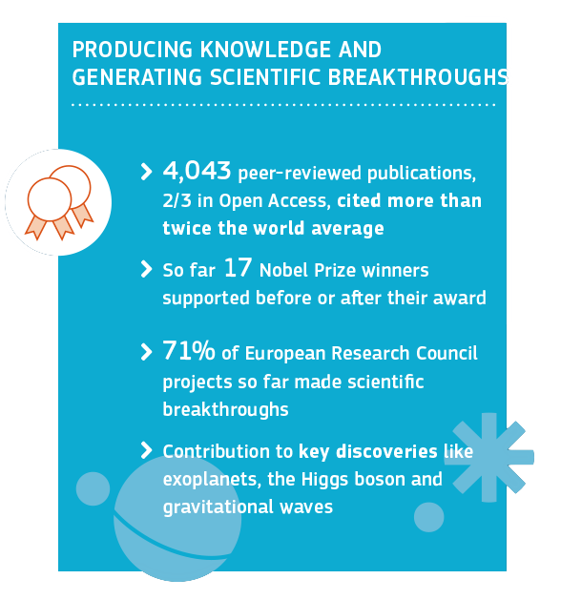
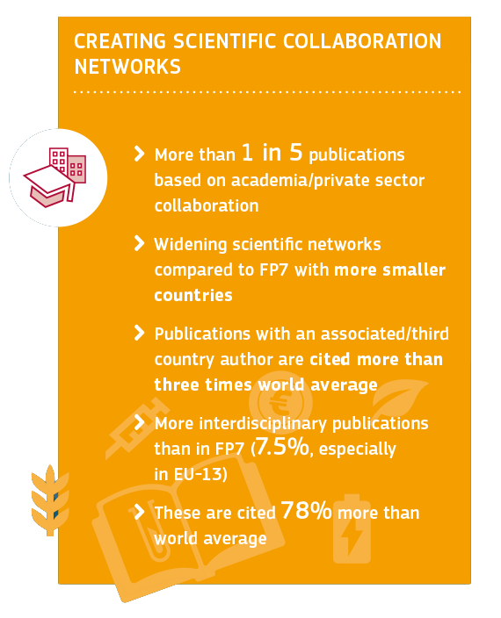
H2020 Interim
evaluation (2014-2017)

Slide 27
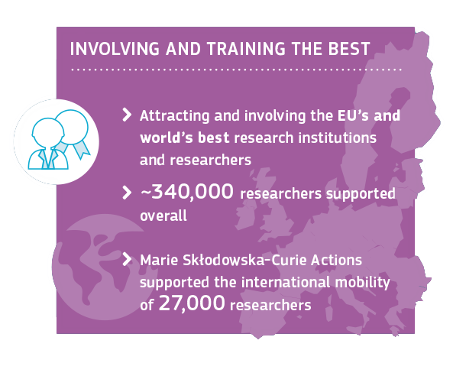
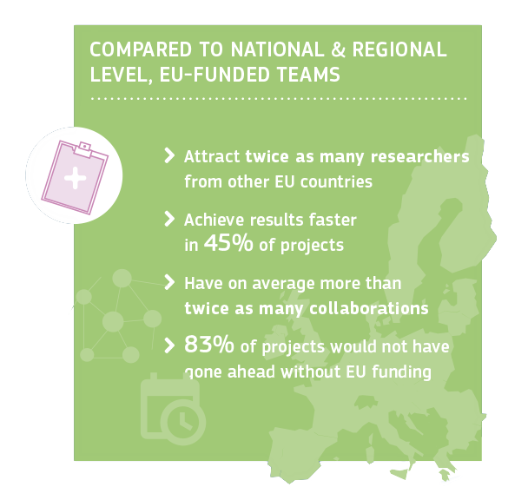
H2020 Interim
evaluation (2014-2017)

Slide 28
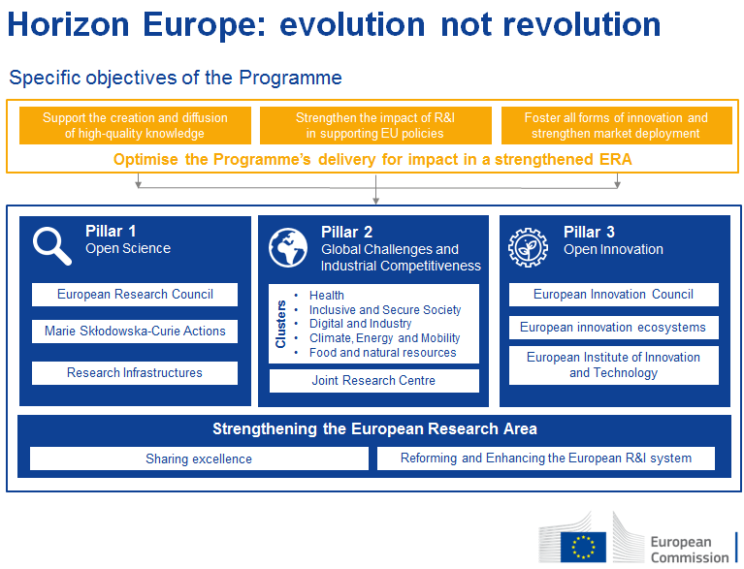

Slide 29
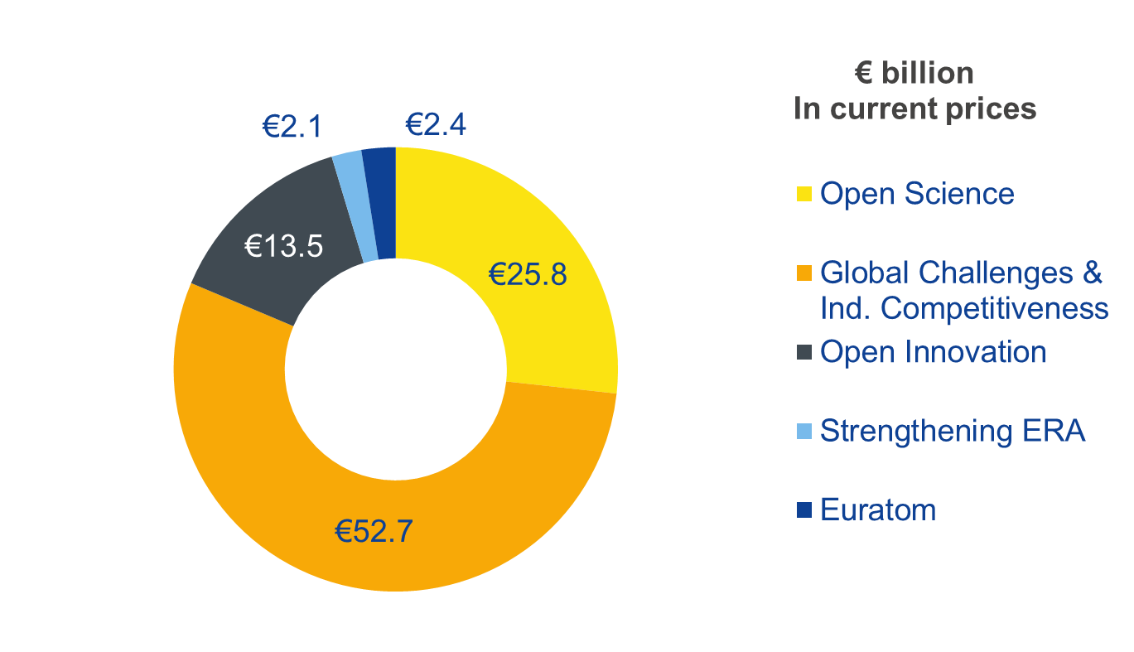
Budget: €100 billion*
* This envelope includes EUR 3.5 billion allocated under the InvestEU Fund.
Notes:
The proposed budget of €100 billion will make Horizon Europe the biggest EU research and innovation programme ever.
It is one of the few parts of the EU budget that the Commission proposes to increase. This increase to the current programme is 50% when taking into account the EU of 27 Member States.
The proposed €100 billion for 2021-2027 includes €2.4 billion for the Euratom research and training programme.
€3.5 billion will be allocated under the InvestEU Fund. The innovation window of InvestEU will provide loans, guarantees, equity and other market-based instruments in the order of € 11,5 billion to mobilise public and private investment in research and innovation.
[Hence the financial envelope for implementing Horizon Europe will be €94.1 billion.]

Slide 30





Lessons Learned Key Novelties from Horizon 2020 Interim Evaluation in Horizon Europe
Support breakthrough innovation
European Innovation Council
Create more impact through mission-orientation and citizens' involvement
R&I Missions
Extended association possibilities
Strengthen international cooperation
Reinforce openness
Open science policy
Rationalise the funding landscape
New approach to Partnerships
Notes:
For each of the novelties, the impact assessment assessed the expected impacts, risks and possible mitigation measures.

Slide 31

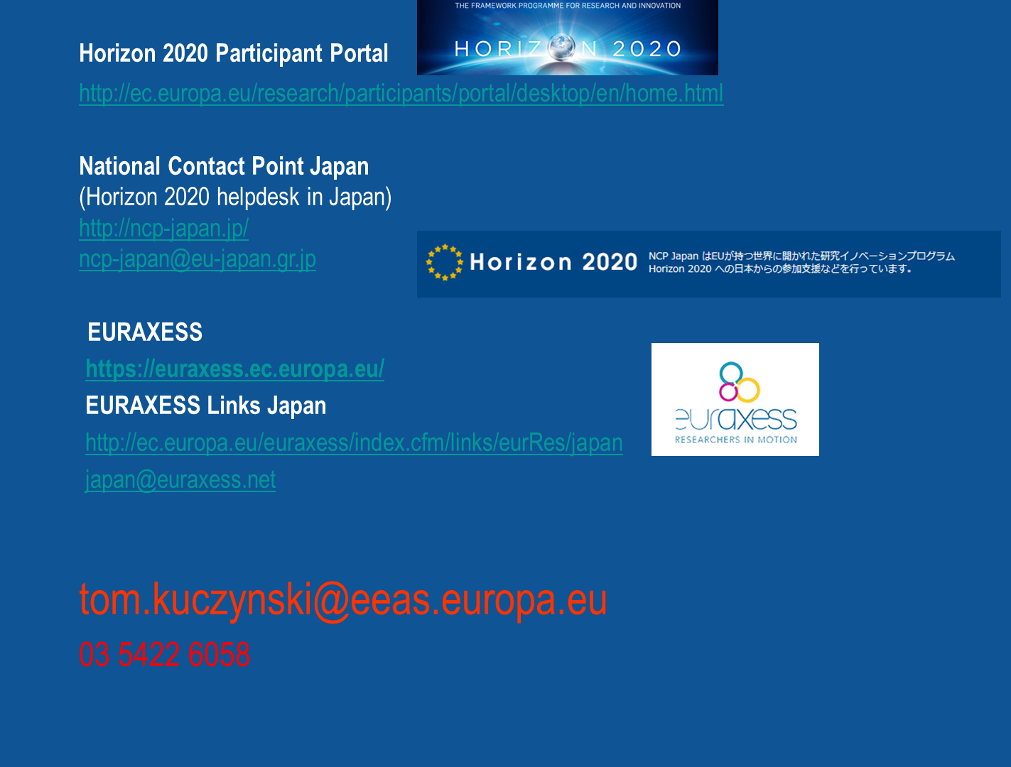





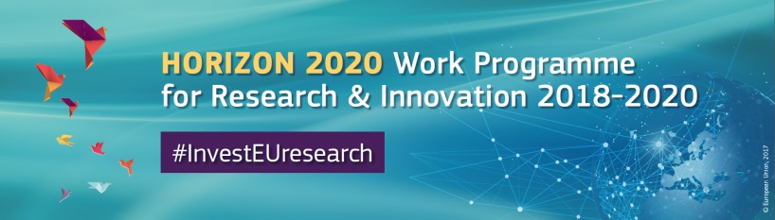

Participant Portal, Japan page :
http://ec.europa.eu/research/participants/data/ref/h2020/other/hi/h2020_localsupp_japan_en.pdf

