Slide 1

European Research Council Grants @ Kyoto University, 28/08 2019
Matthieu Py
EURAXESS Japan Coordinator

Slide 2
The idea behind the ERC
Eligibility of Host Institutions and Researchers
Funding Schemes // Deadlines // Who is eligible for what?
Application and Evaluation Process
Budget Calculation & Administrative Issues
Proposal Writing
Outlook: The Interview

Slide 3
The idea behind the ERC
Eligibility of Host Institutions and Researchers
Funding Schemes // Deadlines // Who is eligible for what?
Application and Evaluation Process
Budget Calculation & Administrative Issues
Proposal Writing
Outlook: The Interview

Slide 4

Research quality as sole criterion
Aiming at excellence
All research fields
Investigator-driven
“Bottom-Up”
Portability of grants
Groundbreaking
Frontier Research
Scientific Autonomy

Slide 5
The idea behind the ERC
Eligibility of Host Institutions and Researchers
Funding Schemes // Deadlines // Who is eligible for what?
Application and Evaluation Process
Budget Calculation & Administrative Issues
Proposal Writing
Outlook: The Interview

Slide 6




Principal Investigator (PI) + Team
additional
Institution
+
Host Institution (HI)

Slide 7
The Principal Investigator (PI)
Leader of the project and head of the project team – submits the application
Any Nationality
At least 50% of working time in Europe
→ Work contract with a European Institution latest at the first day of the project

Slide 8
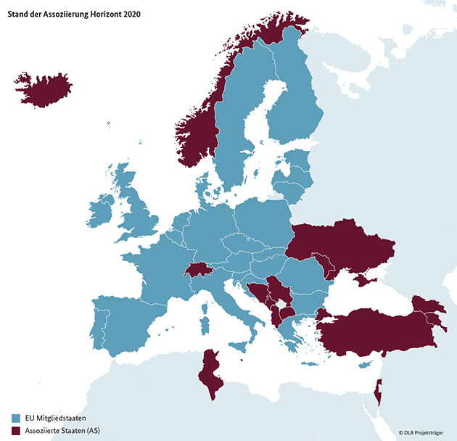

The Host Institution:
28 EU Member States + 16 Associated Countries
28 EU Member States
Associated Countries (AC)
Albania
Armenia
Bosnia & Herzegovina
Faroe Islands
Georgia
Island
Israel
Macedonia
Moldavia
Montenegro
Norway
Switzerland
Serbia
Tunisia
Turkey
Ukraine

Slide 9
The idea behind the ERC
Eligibility of Host Institutions and Researchers
Funding Schemes // Deadlines // Who is eligible for what?
Application and Evaluation Process
Budget Calculation & Administrative Issues
Proposal Writing
Outlook: The Interview

Slide 10
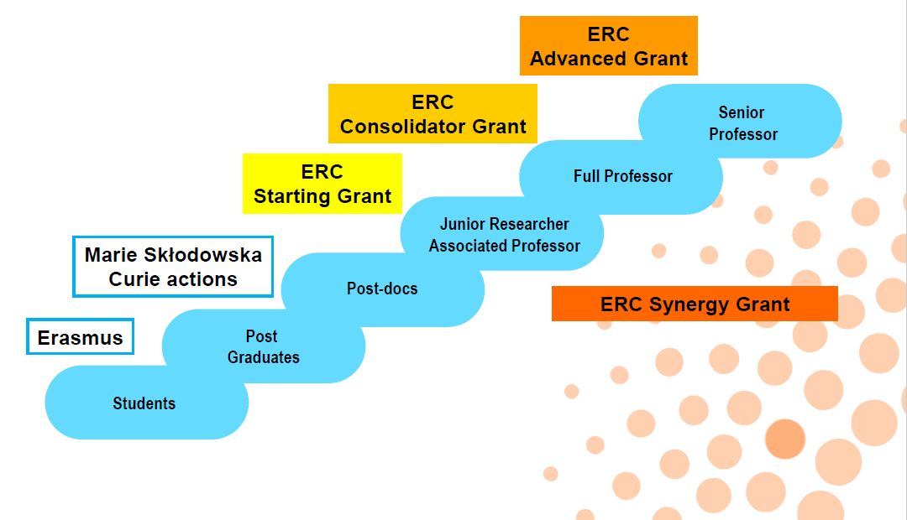
The EU grant ‘escalator’

Slide 11
ERC Funding Schemes
Starting (StG)
Consolidator
(CoG)
Advanced (AdG)
0
2
7
12
Years after PhD

Slide 12
ERC Funding Schemes
 | Starting Grants | Consolidator Grants | Advanced Grants | Synergy Grants
Eligibility | 2-7 years post-PhD | 7-12 years post-PhD | Significant track record in past 10 years | 2-4 PIs, similar cond. Advanced
Funding | ≤1.5 M€ (2M from Japan) | ≤2.0 M€ (2.75M from Japan) | ≤2.5 M€ (3.5M from Japan) | ≤10 M€ (14M from Japan)
Duration | 5 years | 5 years | 5 years | 6 years
# grants | ~400 | ~300 | ~200 | ~30
Success rate | ~11% | ~14% | ~14% | ? (few %) ?
Time in Europe | ≥50% | ≥50% | ≥50% | ≥50%
Work ratio | ≥50% | ≥40% | ≥30% | ≥30%
Deadline | ~ Oct 2019 | ~ Feb 2020 | 29 Aug 2019 | ~ Nov 2019

Slide 13
Profile of Principal Investigator (PI)
Any Nationality
All: At least 50% of working time in Europe
Work contract with a European Institution
latest at the first day of the project
Notes:
Besides these hard criteria the evaluators consider several benchmarks of the researcher profile.
Evaluators are sensitized to take into account the specific research domain and CV of the researcher.
Starting Grant applicants should have at least one and Consolidator Grant applicants more than one important publication without their PhD supervisor.
Other benchmarks include publications as first author in high-ranking international journals, (translated) monographs, conference presentations or (inter)national prizes and awards.
These are soft criteria with no specific details in the official documents
Different for all fields
No knock-out criteria
The applicants are expected to spend at least 50% or 40% of their working time on the ERC project. At the same time, they should spend at least 50% of the total amount of time in Europe.
The evaluation panels will determine whether the PI is strongly committed and if they spend enough time on the project. All proposals should therefore state clearly the amount of active time the PI spends on the project. Every uncertainty should be avoided.
The ERC funding is granted to the individual person and thus asks for a considerable contribution of the PI. The ERC is looking for active researchers, who not only lead the project but are also involved in research to a considerable amount. The proposal should state that the future ERC project will be the main interest of the PI in the coming years.

Slide 14
Profile of Principle Investigator (PI)
Soft (peer-review evaluation)
    Promising Track Record
    At least one (Starting) or several (Consolidator) important publications without PhD supervisor
Starting: At least 50% of working time on the ERC project
Consolidator: At least 40% of working time on the ERC project
Advanced: At least 30% of working time on the ERC project
---------------------------
All: At least 50% of working time in Europe

Slide 15
Profile of Principle Investigator (PI):
Evaluation benchmarks
Evaluators are sensitised to take into account the specific research domain and CV of the researcher.
Starting Grant applicants should have at least one; and Consolidator Grant applicants more than one important publication without their PhD supervisor.
Publications as first author in high-ranking international journals, (translated) monographs, conference presentations or (inter)national prizes and awards.
(Soft criteria with no specific details in the official documents, different for all fields, no knock-out criteria)
The ERC funding is granted to the individual person and thus asks for a considerable contribution of the PI. The ERC is looking for active researchers, who not only lead the project but are also involved in research to a considerable amount. The proposal should state that the future ERC project will be the main interest of the PI in the coming years.

Slide 16

Bottom-Up
All fields of science, all topics
3 scientific domains:
    Physical Sciences & Engineering (PE)
    Life Sciences (LS)
    Social Sciences and Humanities (SH)

Slide 17

What is most important for your proposal?
Your idea!

Slide 18
Exercise: Key Questions on your project (do it in 15’)
Answer the following questions for yourself
Describe the idea of your research project as concise and comprehensive as possible.
Which major challenge/problem is going to be solved?
What are the ground-breaking/visionary aspects of your research project?
What would be the impact on your research field?
What makes you the right person to lead the project? (background, competitors)
Keep it short and simple

Slide 19

Choosing a topic
“Propose a project that comes from your heart”
“Be excited about your project”
Creative, innovative, feasible
An important challenge of your field
Balance between “not ambitious enough” and “too ambitious” – fitting to your profile
Opportunity to define your research field
Unique selling proposition

Slide 20
The idea behind the ERC
Eligibility of Host Institutions and Researchers
Funding Schemes // Deadlines // Who is eligible for what?
Application and Evaluation Process
Budget Calculation & Administrative Issues
Proposal Writing
Outlook: The Interview

Slide 21
Application and Evaluation Process
Proposal
Step 1 Evaluation
Step 2 Evaluation
Part A
Online Forms
Annexes
Eligibility Check
Part B1
0) Abstract
Extended synopsis of the project (5 p.)
CV (2 p.)
Track Record
(2 p.)
Part B1
Part B1 (9 p.)
Part B2:
Extended Scientific Proposal (incl. Resources): 15 p
Part B2 (15 p.)
External Reviews
Interviews
CHECK & USE OFFICIAL TEMPLATE!

Slide 22
Marks & Re-application rules
1st step
A = excellent
B = good but not sufficient
C = unsufficient
2nd step – Final Result
A = excellent
B = good but not sufficient
A: funded
A: unfunded
  B: wait 1 Call!
  C: wait 2 Calls !
  If not funded, direct re-application possible

Slide 23
Indicative Timeline Starting Grants 2020
Oct 2019
Mar/Apr 2020
Jun/Jul
Aug
Sep – Dec 2020
Deadline
Invitation to interview
Interview
Acceptance
Grant Agt. preparation
Rejection Step-1
Rejection
Step-2
Project start date: usually directly after grant signature, latest 6 months after invitation to grant preparation

Slide 24
Choosing the right panel…
25 panels
  10 Physical Sciences and Engineering (PE)
  9 Life Sciences (LS)
  6 Social Sciences and Humanities (SH)
„primary panel“ & if applicable: „secondary panel“
Check
  panel descriptors / key words
  funded projects
  panel members of previous Calls

Slide 25
25 panels for all disciplines
Physical Sciences and Engineering (PE)
PE1: Mathematics
PE2: Fundamental Constituents of Matter
PE3: Condensed Matter Physics
PE4: Physical and Analytical Chemical Sciences
PE5: Synthetic Chemistry and Materials
PE6: Computer Science and Informatics
PE7: Systems and Communication Engineering
PE8: Products and Processes Engineering
PE9: Universe Sciences
PE10: Earth System Science
Life Sciences (LS)
LS1: Molecular and Structural Biology and Biochemistry
LS2: Genetics, Genomics, Bioinformatics and Systems Biology
LS3: Cellular and Developmental Biology
LS4: Physiology, Pathophysiology and Endocrinology
LS5: Neurosciences and Neural Disorders
LS6: Immunity and Infection
LS7: Diagnostic Tools, Therapies and Public Health
LS8: Evolutionary, Population and Environmental Biology
LS9: Applied Life Sciences and Biotechnology
Social Sciences & Humanities (SH)
SH1: Individuals, Markets and Organisations
SH2: Institutions, Values, Environment and Space
SH3: The Social World, Diversity, Population
SH4: Human Mind and Its Complexity
SH5: Culture and Cultural Production
SH 6: The Study of the Human Past

Slide 26
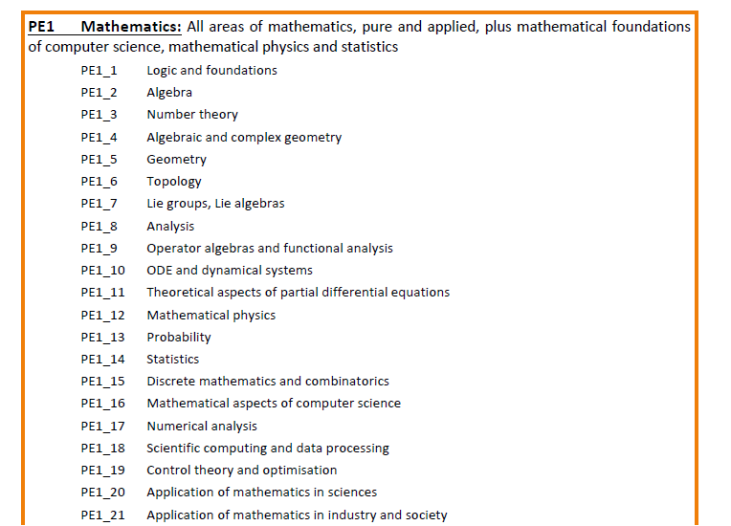
Example: Panel PE1 – Descriptors
Information for Applicants:
http://www.eubuero.de/erc-dokumente.htm
Key words, not sub-panels!

Slide 27

Panel composition
12-16 panel members
From all over the world
Multi-disciplinary
At least 3 reviews from panel members (generalists)
  In Step 2 also external referees (specialists in your field)
Panel discussions in Brussels (before & after interview)

Slide 28

Panel Chairs and Members
Names of panel members of previous Calls:
https://erc.europa.eu/document-category/evaluation-panels
Usually alternating sets of panels
A: 2015, 2017, 2019
B: 2016, 2018, 2020 and so on
Changes every year
Names published after Call evaluation
Names of Panel Chairs published before Deadline
Do not contact Panel Member during evaluation!

Slide 29
What is evaluated?
Excellence of the Research project
Ground-breaking nature and potential impact
  Address important challenges
  Objectives ambitious & beyond the state of the art
  High risk / high gain
Scientific Approach
  Feasibility
  Research methodology appropriate to achieve goals
  Development of novel methodology?
  Timescales, resources and PI commitment adequate & properly justified?

Slide 30
What is evaluated?
Excellence of the Principal Investigator (PI)
Ability to conduct ground-breaking research
Starting/Consolidator: Evidence of creative independent thinking
Have the required scientific expertise and capacity to successfully execute the project?
Advanced: Demonstration of sound leadership in the training and advancement of young scientists

Slide 31
Remember
Evaluators are human beings and scientists like you
It can vary from person to person if they
  take a lot of time / have very little time
  are motivated / are unmotivated to read your proposal
  are close to your field / are far from your field
  are willing to take risks / are hesitant to spend tax payer’s money on risky projects
  are English native speakers / are not completely fluent
  value more the person / value more the idea
  value unconventional CV‘s / want to see big names
  value methodological details / only interested in the big picture
  like to be impressed / very much dislike exaggerations
  like visuals / prefer texts

Slide 32
The idea behind the ERC
Eligibility of Host Institutions and Researchers
Funding Schemes // Deadlines // Who is eligible for what?
Application and Evaluation Process
Budget Calculation & Administrative Issues
Proposal Writing
Outlook: The Interview

Slide 33
Maxmium project budget – includes Overhead
 | Starting Grants StG | Consolidator Grants CoG | Advanced Grants AdG | Synergy Grants SyG
Max. budget | 1.5 Mio. € (2 Mio.€)* | 2 Mio. € (2.75 Mio.€)* | 2.5 Mio. € (3.5 Mio.€)* | 10 Mio. € (14 Mio. €)
* Budget can be higher (maxium sum in ()*) if
project has exceptional high equipment costs
PI moves from a Third Country to an EU member or associated state because of the ERC Grant (higher budget can be used for personell, equipment, relocation cost – but not before the start of the project )
Justification needed

Slide 34
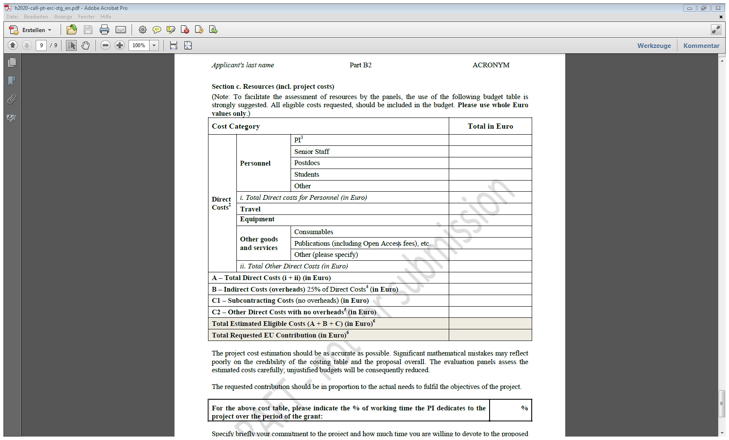
Budget
Table

Slide 35
Funding
Direct Costs– 100%
(partly) Salary of the PI
PostDocs, PhD Students, Technicians etc.
Consumables
Equipment Costs
Travel Costs
Publications Costs
Subcontracts
Other
+ 25% Overhead (to cover indirect costs)
timesheets
Depreciation rates!
Open Access
No ‚core Parts‘
Contact your
Host Institution!!

Slide 36

Resources – Justification (in Part B2)
Explain need of equipment,
intensity of its planned use
Explain what resources are already
available at your institution
In case of “additional institutions”: explain scientific added value
Reviewers may reduce your budget if costs are not justified!

Slide 37
Ethics Issues
COFFEE BREAK!! & ALUMNI INPUT AFTERWARD
Ethics Issues Table online form!
  Human Embryo/ Foetus
  Humans
  Human Cells / Tissues
  Protection of personal data
  Animals
  Non-EU Countries
  Environment Protection
  Dual Use
  Misuse
  Other
  Further information:
  http://ec.europa.eu/research/participants/portal/desktop/en/funding/reference_docs.html#h2020-grants-manual-hi-ethics
A „yes“? – > Ethics review self-assessment
+ additional documentation if already available

Slide 38
The idea behind the ERC
Eligibility of Host Institutions and Researchers
Funding Schemes // Deadlines // Who is eligible for what?
Application and Evaluation Process
Budget Calculation & Administrative Issues
Proposal Writing
Outlook: The Interview

Slide 39
Evaluation Process
Proposal
Step 1 Evaluation
Step 2 Evaluation
Part A
Online Forms
Annexes
Eligibility Check
Part B1
0) Abstract
Extended synopsis of the project (5 p.)
CV (2 p.)
Track Record
(2 p.)
Part B1
Part B1 (9 p.)
Part B2:
Extended Scientific Proposal (incl. Resources): 15 p
Part B2 (15 p.)
External Reviews
Interviews

Slide 40

What do you need to start writing?
Templates B1 / B2
Information for Applicants for your Call
Electronic Submission System via the Participant Portal:
https://ec.europa.eu/info/funding-tenders/opportunities/portal/ ➔H2020➔ERC➔forthcoming
ec.europa.eu/research/participants/data/ref/h2020/other/guides_for_applicants/h2020-guide19-erc-adg_en.pdf
Notes:
40
40

Slide 41
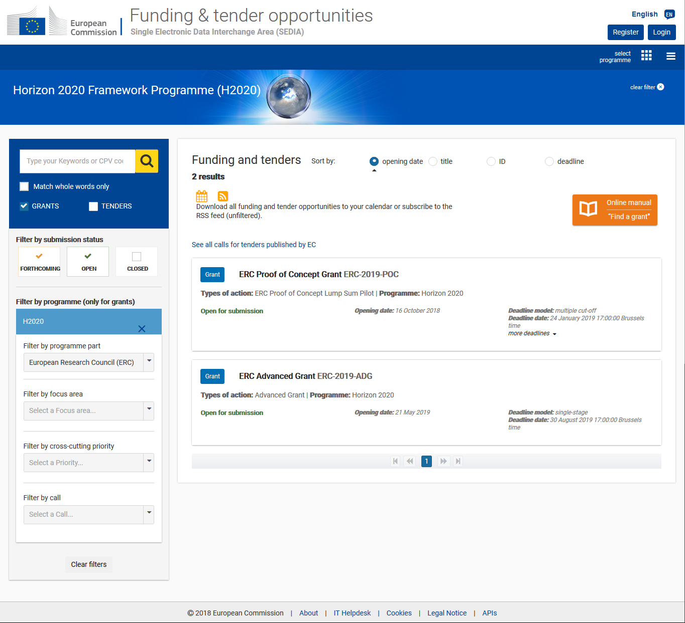

Slide 42
3 versions of your project description
CHECK THE ‘DECRESIM’ PROPOSAL!
In all parts | ☑ Problem
 | State of the Art
 | Hypothesis
 | Goals
 | Frontier Research
 | ☑ Impact
 | ☑ Your Vision
 | ☑ Interdisciplinarity
 | ☑ Risks / Challenges
Part | Target group
Abstract 2000 Characters | All (incl. public)
Part B1 5 pages | Panel
Part B2 15 pages | Panel, + external referees

Slide 43
a. Extended Synopsis (max. 5 pages)
Assessed in Step 1 by panel and in Step 2
Very important to pass step 1 (evaluators have no access to Part B2!)
Short stand-alone version of your project description
  Ground-breaking vs. state of the art
  Raising curiosity
  All relevant aspects (incl. feasibility)
  Including few references to key literature (page limit!)
Understandable for non-specialists
Notes:
43

Slide 44
b. Curriculum Vitae (max. 2 pages) + Funding ID
  Organisation of scientific meeting
  Insitutional responsibilities
  Commission of trust (reviewer, editorial board, evaluator)
  Memberships of scientific societies
  Major collaborations
  Career breaks
  Curriculum Vitae (max. 2 pages)
  Education
  Current Position
  Previous positions
  Fellowships and awards
  Supervision of graduate students and postdoctoral fellows
  Teaching activities
Funding ID (no page restriction):
  For all Ongoing Grants and Applications:
  Project Title, Funding Source, Amount, Period
  Relation to current ERC proposal
  Aim: prevent double funding / see that you will be able to conduct the project

Slide 45

c. Early Achievements Track Record (max. 2 pages)
Begin with: total number of publications and h-index
Select your most important publications (5 or 10?)
Indicate number of citations (if applicable) on each publication
Distinguish publications with
& without PhD supervisor
Don‘t forget: conferences, patents,
prizes and awards!
„Examples of leadership in industrial innovation“
Notes:
45

Slide 46

B2: The Scientific Proposal (max. 15 pages)
Evaluated only in Step 2 by panel & external experts
Respect the given structure:
  State of the art and objectives
  Methodology
  Resources (incl. project costs)
Respect formal parameters
  Times New Roman / Arial or similiar
  Size: at least 11
  Single line-spacing
  Margins: 2 cm side, 1,5 top & bottom
Use B1/B2 templates!

Slide 47

Hints and Tips
Contact the administration of your host institution early
Get PDF’s of these documents:
  Your PhD certificate
  Signed letter “Commitment of the Host Institution
Follow the formatting rules and page limits
Proof-read the proposal several times
Register early, get familiar with the system and templates
A submitted proposal can be revised until the call deadline by submitting a new version and overwriting the previous one
Respect the strict deadline! Usually 17:00 Brussels time - not a millisecond later

Slide 48
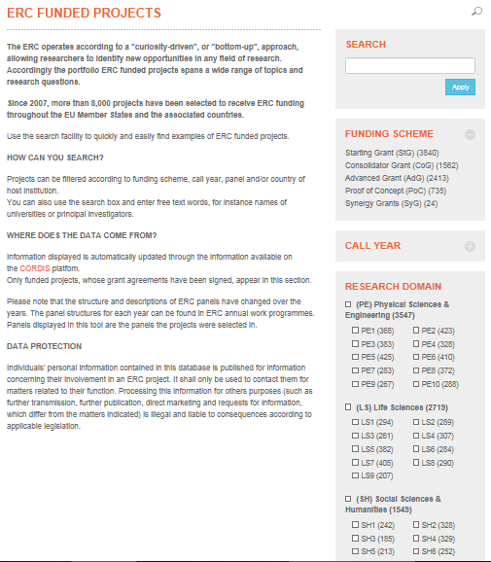
Check ERC funded projects online:
https://erc.europa.eu/projects-figures/erc-funded-projects

Slide 49
The idea behind the ERC
Eligibility of Host Institutions and Researchers
Funding Schemes // Deadlines // Who is eligible for what?
Application and Evaluation Process
Budget Calculation & Administrative Issues
Proposal Writing
Outlook: The Interview

Slide 50

Interview preparation
Many National Contact Points and Host Institution offer „Interview Trainings“
Ask them as soon as you get invited
Ask also colleagues to listen to your talk and give honest feedback

Slide 51
Interviews
In Brussels, Belgium (travel costs paid)
In front of your evaluation panel (no external reviewers)
Usually 30 Minutes in total
Different formats: 5-15 minutes prepared presentation plus questions
Your full proposal is evaluated at this point: the interview might change your proposals’ position on the ranking list

Slide 52

Possible Interview Questions
Project:
  Project idea, preliminary results, limits of the project, risks and challenges
  Innovative potential. Is this really new?
Project Management
  Possible problems, changing methodology
  Team recruitment, team management
Budget
  Necessity of team members / equipment / travels
Notes:
What is the most innovative aspect in in your proposal?
Do you see any risks in your proposal?
Who are your main competitors (names, places)? Why is your approach better?
How do you see the future of your research field? How will your research results change this field?

Slide 53
Possible Interview Questions II
Independence from PhD-supervisor
Experiences with leading a team / supervision of students
Your own qualifications and your ability to lead interdisciplinary research
Your achievements, publications etc.
Your career prospects
Notes:
What does the ERC Grant mean for your personal development?
Which are your most important papers? What was your contribution to these publications?

Slide 54
Lessons learnt today
You need to have a really good scientific idea
Talk to your contacts in Europe soon about it (scientists, host institution, national contact point)
Always remember the situation and perspective of the reviewer when writing your proposal
Be exited about your project ☺

Slide 55

Not ready for your own application yet?
Work in an already established ERC team in Europe for some weeks or months
Eligible for JSPS Fellows (特別研究員) since 2015 and JST-backed researchers since 2018
Further information:
  http://www.jsps.go.jp/j-pd/pd_user-haken.html (Japanese)
  https://erc.europa.eu/funding/additional-opportunities#International%20Arrangement%20funding

Slide 56

Procedure
ERC sends expressions of interest to PI’s of running ERC projects in Europe: interested in hosting a JSPS Fellow?
ERC sends JSPS/JST the list of interested PI’s/teams with project description (Autumn)
JSPS/JST informs their Fellows (deadline~spring)

Slide 57
What is funded?
Research Visits in ERC projects in Europe – as long as the limit of duration for overseas visit stipulated in the JSPS/JST Guidelines
JSPS Fellows continue to receive their stipend from JSPS/JST during their visit in Europe
Travel expenses covered according to JSPS/JST guidelines
ERC At least 12 months prior to the termination date of the MEXT-funded project
The ERC grant can cover subsistence costs (per diem), consumables, conferences etc. – with direct relation to the ERC-project

Slide 58
Synergy Grants

Slide 59


Synergy Grants
Bring together complementary skills, knowledges in new ways, in order to jointly address ambitious research problems

Slide 60
Synergy Grants - Eligibility
2 – 4 „Principal Investigators“ with their teams
No restrictions on location of PIs
  Can come from the same group within one HI, different HIs within one country or from different countries (within EU or AC)
  In 2020 call: possible to have even 1 of the PI‘s outside EU/AC
Early stage researcher or experienced researcher with proven track record – each person is evaluated on his/her specific career stage
Time commitment: ≥50% of working time in EU or AC and ≥30% of working time on the ERC project
Notes:
PIs to be considered as equal, but a corresponding PI to be designated who will be the administrative contact for the duration of the project.
jointly address ambitious research problems.
The aim is to promote substantial advances at the frontiers of knowledge, to cross-fertilize scientific fields, and to encourage new productive lines of enquiry and new methods and techniques, including unconventional approaches and investigations at the interface between established disciplines. This should enable transformative research not only at the forefront of European science but also to become a benchmark on a global scale.
Applicants Principal Investigators must demonstrate the synergies, complementarities and added value that could lead to breakthroughs that would not be possible by the individual Principal Investigators working alone.

Slide 61
Synergy Grants
  Deadline mid November 2019
  Budget: approx. 400 Mio.€
  Project budget max. 10 Mio.€ (+4 Mio.€ for
  exceptional equipment)
  Funding of ca. 25-30 projects
  Very strict resubmission rules for all PIs
Notes:
ERC foresees the Synery Grant call to be a highly competitive call
only exceptional proposals are likely to be funded that will demonstrate that the truly ambitious research questions could lead to breakthroughs only through the joint effort of the complementary and synergistic group of PIs.
‘Synergy’ is not simply a successful collaboration
The interaction would yield something more than just the sum of the individual parts.
To yield possibly either unforeseen, completely new science, to cross fertilize disciplines or to solve important research problems that until now could not be dreamt of solving.
Tough future restrictions on submissions planned
applicants to think twice before applying: PIs evaluated with a C score in 2018 will not be able to apply to any ERC call in 2019.

Slide 62
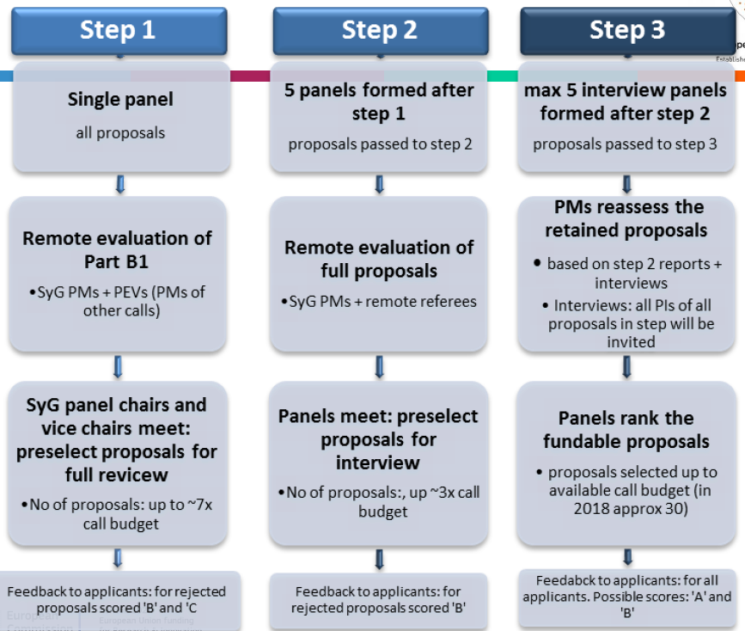
Source: ERCEA, June 2018

Slide 63
Synergy Grant Proposal
Part A
Part B
Administrative Forms/
Proposal Submission Forms
  1 - General Information
  2 - Participants & Contacts
  3 - Budget
  4 - Ethics
  5 - Call-specific questions
B1
B2
Extended synopsis
Scientific
proposal
CV
Track record
Annexes
  Host Support Letter (Host Institution Binding Statement of Support)
  PhD-Certificate (+ additional documents)
  (Ethics Self-Assessment)
Notes:
For Synergy Grant applications, only the host institution of the Corresponding Principal Investigator must confirm its association with and its support to the project and the Corresponding Principal Investigator, listing the other participating Principal Investigators. However, if the application is successful and there is more than one host institution, each of the host institutions shall offer the commitments set out above subject to a supplementary agreement between the Principal Investigator or Principal Investigators and the host institution.

Slide 64
Part B in Detail
B1
B2
Extended synopsis
5 p.
Scientific proposal
CV of each PI
2 p.
15 p.
Track record of each PI
2 p.
Additionally:
References
Resources (B2)

